Slide 1

E-commerce 2020-2021: Business. Technology. Society.
Sixteenth Edition, Global Edition
Chapter 5
E-commerce Business Strategies
Copyright © 2021 Pearson Education Ltd. All Rights Reserved
Notes:
If this PowerPoint presentation contains mathematical equations, you may need to check that your computer has the following installed:
1) MathType Plugin
2) Math Player (free versions available)
3) NVDA Reader (free versions available)

Slide 2
Learning Objectives
5.1 Identify the key components of e-commerce business models.
5.2 Describe the major B2C business models.
5.3 Describe the major B2B business models.
5.4 Understand key business concepts and strategies applicable to e-commerce.
Notes:
Slide 2 is list of textbook LO numbers and statements

Slide 3
E-commerce Business Models
Business model
Set of planned activities designed to result in a profit in a marketplace
Business plan
Describes a firm’s business model
E-commerce business model
Uses/leverages unique qualities of Internet and Web

Slide 4
E-commerce Business Models Category
There are many e-commerce business models, and more and more are being invented every day.
The number of such models is limited only by the human imagination and list of models is certainly not exhaustive.
It is important to note that there is no one correct way to categorize these business models.
E-commerce business models would be incomplete without e-commerce enablers, which provide hardware, OS software, networks and communications technology, application software, web design, consulting services etc

Slide 5
E-commerce Enablers
E-COMMERCE ENABLERS
INFRASTRUCTURE | PLAYERS
Hardware: Web Servers | HP, Dell, Lenovo
Software: Web Server Software | Microsoft, IBM, Red Hat Linux (Apache) , Oracle
Cloud Providers | Amazon Web Services, Microsoft Azure, IBM Cloud, Google Cloud Platform
Hosting Services | Liquid Web, Weblntellects , 1&1, HostGator, Hostway
Domain Name Registration | GoDaddy, Network Solutions, Dotster
Content Delivery Networks | Akamai, Limelight Networks, Amazon CloudFront
Site Design | Weebly, Wix, Squarespace, Jimdo
Small/Medium Enterprise E-commerce | Shopify, BigCommerce YoKart Platforms
Enterprise E-commerce Platforms | Magento, IBM, Oracle, Salesforce, SAP, Intershop
M-commerce Hardware Platforms | Apple, Samsung, LG
M-commerce Software Platforms | Mobify, PredictSpring, Usablenet, GPShopper
Streaming, Rich Media, Online Video | Adobe, Apple, Webcollage
Security and Encryption | VeriSign, Check Point, GeoTrust, Entrust Datacard, Thawte, Intel Security
Payment Systems | PayPal, Authorize.net, Chase Paymentech, Cybersource
Web Performance Management | Compuware, SmartBear, Dynatrace
Comparison Engine Feeds/Marketplace Management | ChannelAdvisor, CommerceHub, CPC Strategy
Customer Relationship Management | Oracle, SAP, Salesforce, Microsoft Dynamics
Order Management | JDA Software, Jagged Peak, Monsoon
Fulfillment | JDA Software, Jagged Peak, CommerceHub
Social Marketing | Buffer, HootSuite, SocialFlow
Search Engine Marketing | iProspect, ChannelAdvisor, Merkle
E-mail Marketing | Constant Contact, Cheetah Digital, Bronto Software, MailChimp
Affiliate Marketing | CJ Affiliate, Rakuten LinkShare
Customer Reviews and Forums | Bazaarvoice, PowerReviews BizRate
Live Chat/CIick-to-Call | LivePerson, Bold360, Oracle
Web Analytics | Google Analytics, Adobe Analytics, IBM Digital Analytics, Webtrends

Slide 6
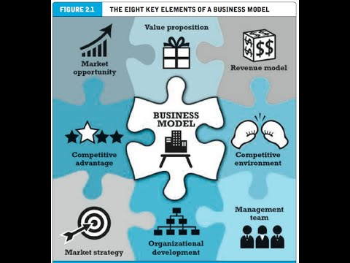
Eight Key Elements of a Business Model

Slide 7
Eight Key Elements of a Business Model
Value proposition
Revenue model
Market opportunity
Competitive environment
Competitive advantage
Market strategy
Organizational development
Management team

Slide 8
1. Value Proposition
“Why should the customer buy from you?”
Defines how a company’s product or service fulfils the needs of customers
Successful e-commerce value propositions:
Personalization/customization
Reduction of product search, price discovery costs
Facilitation of transactions by managing product delivery

Slide 9
2. Revenue Model
“How will you earn money?”
Major types of revenue models:
Advertising revenue model
Receives fees from advertisers.
Subscription revenue model
Freemium strategy
Transaction fee revenue model
Receives a fee for enabling of executing a transaction
Sales revenue model
Derives revenue by selling goods, information, or services
Affiliate revenue model
Steering business to an affiliate and receives a referral fees or percentage of the revenue from resulting sales.

Slide 10
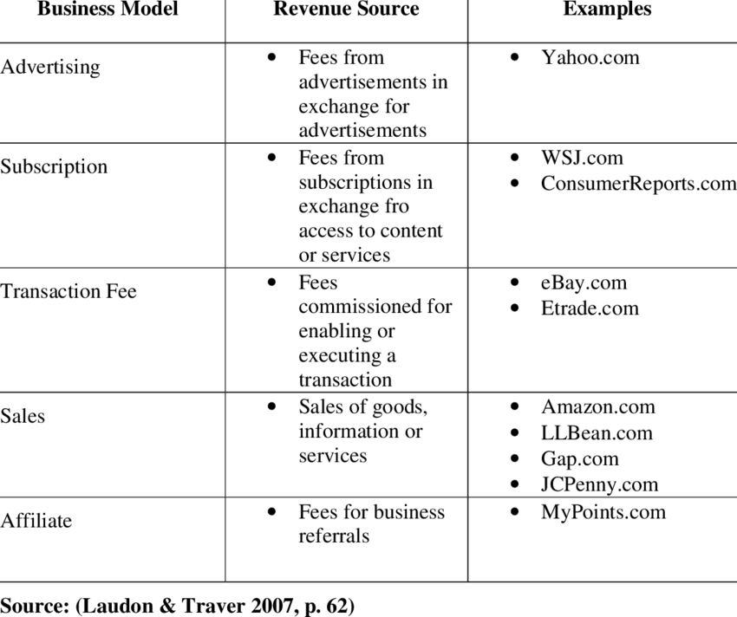
2. Revenue Model

Slide 11
Insight on Society: MADE.com: Furniture for the Crowd
Class discussion:
What revenue model does Made.com use? What other revenue models might be appropriate?
Are social media sources a reliable indication of current and future trends?
To what extent is Made.com not only a product, but also a solution to the needs of Millennials?

Slide 12
3. Market Opportunity
“What marketspace do you intend to serve and what is its size?”
Marketspace: Area of actual or potential commercial value in which company intends to operate
Realistic market opportunity: Defined by revenue potential in each market niche in which company hopes to compete
Market opportunity typically divided into smaller niches

Slide 13
4. Competitive Environment
“Who else occupies your intended marketspace?”
Other companies selling similar products in the same marketspace
Includes both direct and indirect competitors
Influenced by:
Number and size of active competitors
Each competitor’s market share
Competitors’ profitability
Competitors’ pricing

Slide 14
5. Competitive Advantage
“What special advantages does your firm bring to the marketspace?”
Is your product superior to or cheaper to produce than your competitors’?
Important concepts:
Asymmetries
Exists whenever one participant in a market has more resources than other participants.
First-mover advantage
A firm that results from being the first into a marketplace with a serviceable product or service
complementary resources (marketing, management, financial assets)
Unfair competitive advantage (brand name)
Leverage
When a company uses its competitive advantages to to achieve more advantage in surrounding markets
Perfect markets – all firms have equal access to all the factors of production

Slide 15
6. Market Strategy
“How do you plan to promote your products or services to attract your target audience?”
Details how a company intends to enter market and attract customers
Best business concepts will fail if not properly marketed to potential customers

Slide 16
7. Organizational Development
“What types of organizational structures within the firm are necessary to carry out the business plan?”
Describes how firm will organize work
Typically, divided into functional departments
As company grows, hiring moves from generalists to specialists

Slide 17
8. Management Team
“What kind of backgrounds should the company’s leaders have?”
A strong management team:
Can make the business model work
Can give credibility to outside investors
Has market-specific knowledge
Has experience in implementing business plans

Slide 18
Raising Capital
Seed capital,
an entrepreneur’s personal funds, derived from savings, credit card advances, home equity loans or from family and friends
Elevator pitch
Traditional sources
Incubators(accelerators) provide a small amount of funding and an array of services to start-up companies.
angel investors, wealthy individuals investing for an equity share in the stock of a business
Commercial banks, venture capital firms
Strategic partners
Crowdfunding - Kickstarter, Indiegogo
J O B S Act (Jumpstart Our Business Startups)
Notes:
Seed money, sometimes known as seed funding or seed capital, is a form of securities offering in which an investor invests capital in a startup company in exchange for an equity stake or convertible note stake in the company.
An elevator pitch is a brief, persuasive speech that you use to spark interest in what your organization does.
Well known incubators include INiTs(Austria), Accelarate (Denmark), Numa (France), and SeedRocket(Spain)
An angel investor is someone who invests their own money in a small business in exchange for a minority stake (usually between 10% and 25%). Angel investors tend to be entrepreneurs or people with extensive experience in the business world. However, angel investment is about more than just money.
Angel investors are rich persons who invest their own money in companies. Venture capitalists are employees of risk capital companies who invest other persons' money in companies.
The Jumpstart Our Business Startups Act, or JOBS Act, is a law intended to encourage funding of small businesses in the United States by easing many of the country's securities regulations. It passed with bipartisan support, and was signed into law by President Barack Obama on April 5, 2012
Crowdfunding involves using the Internet to enable individuals to collectively contribute money to support a project.
Top 10 crowdfunding websites:
Best Overall: Kickstarter
Runner Up: Indiegogo
Best for Creators: Patreon
Best for Shopify Stores: Crowdfunder
Best for Personal: GoFundMe
Best for Small Businesses: Fundable
Best for UK and Europe: Crowdcube
Best for Nonprofits: Mightycause
Best for Seed-Stage Companies: SeedInvest
Best for High-Growth Startups: StartEngine
Crowdfunding is becoming a mainstay in the development of movies, video games, art installation and man y other types of projects.
In UK, a 3-D game called Yooka-Laylee created by Playtonic games raised almost £2.1 million from over 73000 backers

Slide 19
Insight on Business: Crowdfunding Takes Off
Class Discussion
What types of projects and companies might be able to most successfully use crowdfunding?
Are there any negative aspects to crowdfunding?
What obstacles are presented in the use of crowdfunding as a method to fund startups?
Notes:
the practice of funding a project or venture by raising money from a large number of people who each contribute a relatively small amount, typically via the internet.
"musicians, filmmakers, and artists have successfully raised funds and fostered awareness through crowdfunding"

Slide 20
Categorizing E-commerce Business Models
No one correct way to categorize
Text categorizes according to:
E-commerce sector (e.g., B2B)
E-commerce technology (e.g., m-commerce)
Similar models appear in different sectors
Companies may use multiple business models (e.g., eBay, Amazon)
E-commerce enablers
Notes:
E-commerce enabler is a company that provides end-to-end solution for brands to do e-commerce business.
Those services include official store management, digital marketing, creative services, customer service management, supply chain management & fulfilment.

Slide 21
B2C Business Models
The size is of approximately $4.3 trillion in 2019
E-tailer
Community provider (social network)
Content provider
Portal
Transaction broker
Market creator
Service provider

Slide 22
B2C Models: E-Tailer
Online version of traditional retailer
Revenue model: Sales
Variations:
Virtual merchant - Amazon, Blue Nile, Bluefly
Bricks-and-clicks – Walmart, Target
Catalog merchant – L.L.Bean, LilianVernon
Manufacturer-direct – Dell, Mattel,Nike
Low barriers to entry

Slide 23
B2C Models: Community Provider
Provide online environment (social network) where people with similar interests can transact, share content, and communicate
Examples: Facebook, LinkedIn, Twitter, Pinterest
Revenue models:
Typically, hybrid, combining advertising, subscriptions, sales, transaction fees, and so on

Slide 24
B2C Models: Content Provider
Digital content on the Web:
News, music, video, text, artwork
Revenue models:
Use variety of models, including advertising, subscription; sales of digital goods
Key to success is typically owning the content
Wall Street Journal, Netflix, Apple Music
Variations:
Syndication, collect and distribute content produced by others.
Aggregators, collect, add their own content and then distribute.
Notes:
Content syndication is the republishing of owned content to other sites. Content syndication increases the reach of content by introducing it to new audiences.
A content aggregator is an entity that pulls together web or media content, applications or both from online sources for reuse or resale. It’s a means of curating content.
LexisNexis has been aggregating content for more than four decades.
Confused.com is an aggregator

Slide 25
Insight on Technology: Connected Cars and the Future of E-commerce
Class Discussion
What is the Internet of Things (I o T)?
What value does the I o T have for businesses?
What impact does the I o T have on the content industry?
What impact does the I o T have on vehicles?
Are there any disadvantages to “connected” cars?

Slide 26
B2C Business Models: Portal
Search plus an integrated package of content and services
Revenue models:
Advertising, referral fees, transaction fees, subscriptions for premium services
Variations:
Horizontal/general (example: Yahoo, A O L, M S N,Facebook)
Vertical/specialized (vortal) (example: Sailnet)
Search (example: Google, Bing)

Slide 27
B2C Models: Transaction Broker
Process online transactions for consumers
Primary value proposition-saving time and money
Revenue model:
Transaction fees
Industries using this model:
Financial services
Travel services
Job placement services

Slide 28
B2C Models: Market Creator
Create digital environment where buyers and sellers can meet and transact
Examples: Priceline, eBay, Etsy
Revenue model: Transaction fees, fees to merchants for access
On-demand service companies (sharing economy): platforms that allow people to sell services
Examples: Uber, Airbnb

Slide 29
B2C Models: Service Provider
Online services
Example: Google-Google Maps, Gmail, and so on
Value proposition
Valuable, convenient, time-saving, low-cost alternatives to traditional service providers
Revenue models:
Sales of services, subscription fees, advertising, sales of marketing data

Slide 30
E-commerce Models
B2C BUSINESS MODELS
BUSINESS MODEL | VARIATIONS | EXAMPLES | DESCRIPTION | REVENUE MODELS
E-tailer | Virtual Merchant | Amazon Blue Nile Bluefly | Online version of retail store, where customers can shop at any hour of the day or night without leaving their home or office | Sale of Goods
 | Bricks-and-Clicks | Walmart Target | Online distribution channel for a company that also has physical stores | Sale of Goods
 | Catalogue Merchant | L.L. Bean | Online version of direct mail catalogue | sale of goods
 | ManufacturerDirect | Dell Mettel Nike | Manufacturer uses online channel to sell direct to customer | sale of goods
Community Provider |  | Facebook LinkedIn Twitter Pinterest | Sites where individuals with particular interests, hobbies, common experiences, or social networks can come together and “meet’” online | advertising subscription, affiliate referral fees
Content Provider |  | Wall Street Journal Apple music Netflix | Offers customers newspapers, magazines, books, film, television, music, games, and other forms of online content | Advertising, subscription fees, sale of digital goods
Portal | Horizontal/General | Yahoo AOL MSN Facebook | Offers an integrated package of content, search, and social network services: news, e-mail, chat, music downloads, video streaming, calendars, etc. seeks to be a user’s homebase | Advertising, subscription fees, transaction fees
 | Vertical/ Specialised(Vortal) | Sailnet | Focuses on a particular subject matter or market segment | Advertising, subscription fees, transaction fees
 | Search | Google Bing | Focuses primarily on offering such services | Advertising, affiliate reference
Transaction Broker |  | E*Trade Expedia Monster Travelocity Orbitz | Pprocesses of online transactions, such as stockbrokers and travel agents, that increases customers productivity by helping them get things done faster and more cheaply | Transaction fees
Market Creator |  | EBay Etsy Uber Airbnb | Businesses that use Internet technology to create markets that bring buyers and sellers together | Transaction fees
Service Provider |  | Envoy Wave RocketLawyer | Companies that make money by selling users a service rather than a product | Sales of services

Slide 31
B2B Business Models
It is more than six times the size of B2C e-commerce in 2019
Net marketplaces
E-distributor
E-procurement
Exchange
Industry consortium
Private industrial network
Notes:
B2B e-commerce is estimated to be $27 trillion in 2019

Slide 32
B2B Models: E-Distributor
Version of retail and wholesale store, M R O goods, and indirect goods
Owned by one company seeking to serve many customers
Revenue model: Sales of goods
Example: Grainger
Notes:
Maintenance, Repair and Operations

Slide 33
B2B Models: E-Procurement
Creates digital markets where participants transact for indirect goods
B2B service providers, S a a S and P a a S providers
Scale economies (efficiencies that arise from increasing the size of a business)
Revenue model:
Service fees, supply-chain management, fulfillment services
Example: Ariba

Slide 34
B2B Models: Exchanges
Independent digital marketplace where hundreds of suppliers meet a smaller number of very large commercial purchasers and conduct transactions.
Exchanges make it significantly less expensive and time-consuming to identify potential suppliers, customers, and partners and to do business with each other.
Revenue model: Transaction, commission fees
Create powerful competition between suppliers
Tend to force suppliers into powerful price competition; number of exchanges has dropped dramatically
Example: Go2Paper
Notes:
An Exchange is an independent digital marketplace where hundreds of suppliers meet a smaller number of very large commercial purchasers

Slide 35
B2B Models: Industry Consortia
Industry-owned vertical digital marketplaces that serve specific industries, such as the automobile, aerospace, chemical, floral, or logging industries open to select suppliers.
Horizontal marketplaces sell specific products and services to a wide range of companies.
More successful than exchanges
Sponsored by powerful industry players
Strengthen traditional purchasing behavior
Revenue model: Transaction, commission fees
Example: SupplyOn
Notes:
Industry consortia are industry-owned vertical marketplaces that serve specific industries, such as the automobile, aerospace, chemical, floral or logging industries.

Slide 36
Private Industrial Networks
Digital network used to coordinate the flow of communications among firms engaged in business together.
Typically evolve out of large company’s internal enterprise system
Key, trusted, long-term suppliers invited to network
Example: Walmart’s network for suppliers
Notes:
A private industrial network ( sometimes referred to as a private trading exchange or PTX)

Slide 37
E-commerce Models
B2B BUSINESS MODELS
Business Model | Examples | Description | Revenue Model
NET MARKETPLACE
E-distributor | Grainger Amazon business | Single-firm online version of retail and also store; supply maintenance, repair, operation goods; indirect inputs | Sale of goods
E-procurement | Ariba Supplier Network Proactis | Single firm creating digital markets where sellers and buyers transact for indirect inputs | Fee for market-making services, supply chain management, and fulfilment services
Exchange | Go2Paper | Independently owned vertical digital marketplace for direct inputs | Fees and commissions on transactions
Industry Consortium | The Seam SupplyOn | Industry-owned vertical digital market open to select suppliers | Fees and commissions on transactions
PRIVATE INDUSTRIAL NETWORK
 | Walmart Procter and gamble | Company-owned network that coordinates supply chains with a limited set of partners | Cost absorbed by network owner and recovered through production and distribution efficiencies

Slide 38
How E-commerce Changes Business
E-commerce changes industry structure by changing:
Rivalry among existing competitors
Barriers to entry
Threat of new substitute products
Strength of suppliers
Bargaining power of buyers
Industry structural analysis
Notes:
Industry Structure Analysis is an effort to understand and describe the nature of competition in an industry, the nature of substitute products, the barriers to entry, and the relative strength of consumers and suppliers

Slide 39
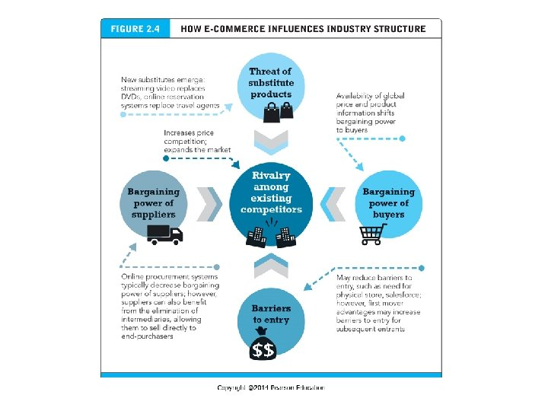

Slide 40
Industry Value Chains
Set of activities performed by suppliers, manufacturers, transporters, distributors, and retailers that transform raw inputs into final products and services
Internet reduces cost of information and other transactional costs
Leads to greater operational efficiencies, lowering cost, prices, adding value for customers

Slide 41
Figure 5.4 E-commerce and Industry Value Chains
Every industry can be characterized by a set of value-adding activities performed by a variety of actors. E-commerce potentially affects the capabilities of each player as well as the overall operational efficiency of the industry.
Six generic players in an Industry Value Chain
Notes:
Figure 5.4, Page 90.
Full description: A flow diagram illustrates the six generic players in e-commerce and industry value chains. The players are as follows: Suppliers, Manufacturers, Distributors, Retailers, Customers, and Transporters. Players in the system use different types of systems. Manufacturers use supply chain management systems, Distributors use Inventory Management Systems; Retailers use Efficient Customer Response Systems. Transporters use Transportation Management Systems. The Web provides an alternative direct channel.

Slide 42
Firm Value Chains
Activities that a firm engages in to create final products from raw inputs
Each step adds value
Effect of Internet:
Increases operational efficiency
Enables product differentiation
Enables precise coordination of steps in chain

Slide 43
Figure 5.5 E-commerce and Firm Value Chains
Every firm can be characterized by a set of value-adding primary and secondary activities performed by a variety of actors in the firm. A simple firm value chain performs five primary value-adding steps: inbound logistics, operations, outbound logistics, sales and marketing, and after sales service.
Notes:
Figure 5.5, page 91.
Full description: An image shows the primary activities and secondary activities in e-commerce and firm value chains. The secondary activities are Administration, Human Resources, Information Systems, Procurement, and Finance slash Accounting. The primary activities are Inbound Logistics, Operations, Outbound Logistics, Sales and Marketing, and After Sales Service.

Slide 44
Firm Value Webs
Networked business ecosystem that coordinates the value chains of several firms.
Uses Internet technology to coordinate the value chains of business partners.
Coordinates a firm’s suppliers with its own production needs using an Internet-based supply chain management system.

Slide 45
Figure 5.6 Internet-Enabled Value Web
Internet technology enables firms to create an enhanced value web in cooperation with their strategic alliance and partner firms, customers, and direct and indirect suppliers.
Notes:
Figure 5.6, page 92.
Full description: A diagram illustrates Internet-enabled value web by showing how a firm or industry transacts with several value chains outside it. The diagram shows a cloud labeled firm slash industry in the center connected by two-way arrows to four other clouds surrounding it. The firm has ERP Systems and Legacy Systems. The first cloud represents Strategic Alliance and Partner Firms. The second cloud represents Customers, who are connected to the firm through Customer Relationship Management or C R M systems, the third cloud represents Indirect Suppliers or M R O, and the fourth cloud represents Direct Suppliers, who are connected to the firm through Supply Chain Management Systems such as Private Industrial Networks and Net Marketplaces.

Slide 46
Business Strategy
Plan for achieving superior long-term returns on capital invested: that is, profit
Five generic strategies
Product/service differentiation
Cost competition
Scope
Focus/market niche
Customer intimacy
Notes:
Product/service differentiation:
- Refers to all the ways producers can make their products or services unique and different in order to distinguish them from those of competition. Ex:Warby Parker (vintage-inspired prescription eyeglasses)
Cost competition:
- Offering products and services at a lower cost than competitors - Ex:Walmart, ASDA
Scope:
- Competing in all markets around the globe, rather than merely in local, regional, or national markets – Ex: Apple devices
Focus/market niche:
- Competing within a narrow market or product segment. Ex – Bonobos (Men’s clothing)
Customer intimacy:
- Developing strong ties with customers. Ex:Amazon, Netflix

Slide 47
E-commerce Technology and Business Model Disruption
Disruptive technologies
technologies that underpin a business model disruption
Digital disruption
a business model disruption that is driven by changes in information technology
Sustaining technology
technologies that enable the incremental improvement of products and services
Stages
Disruptors introduce new products of lower quality
Disruptors improve products
New products become superior to existing products
Incumbent companies lose market share
Notes:
Disruptive technologies – technologies that underpin a business model disruption
Digital disruption – a business model disruption that is driven by changes in information technology
Sustaining technologies – technologies that enable the incremental improvement of products and services
Disruptors – the entrepreneurs and their business firms that lead a business model disruption

Slide 48
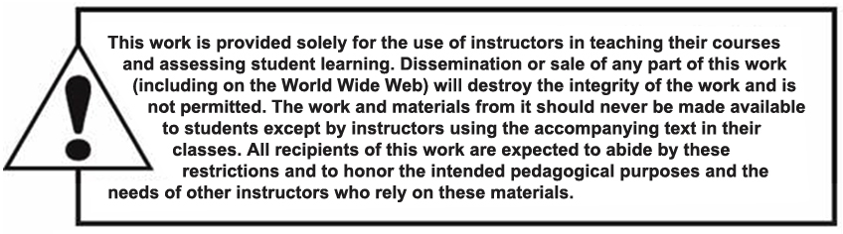
Copyright

